Slide 1

Power BI Project - Data Analysis and Visualization
| Retail Store Transactions
ALBIN K A
12/05/2025

Slide 2
Introduction
In today's data-driven world, the ability to clean, transform, analyze, and visualize data effectively is crucial for making informed decisions. This Power BI project aims to demonstrate the power of data analytics by leveraging key features of Power BI,
including Power Query Editor, DAX functions, and interactive dashboards.

Slide 3
Dataset Overview
Retail Store Transactions dataset contains Sl_No,Date,CustomerID,TransactionID,SKU Category,
SKU(Stock Keeping Unit ),Quantity,Sales Amount.

Slide 4
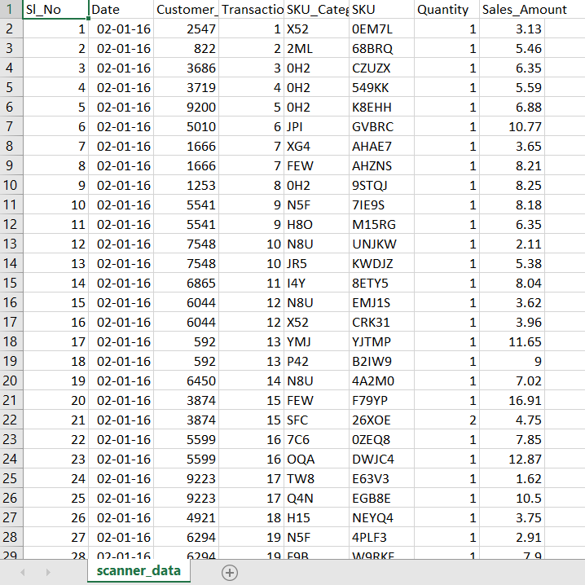
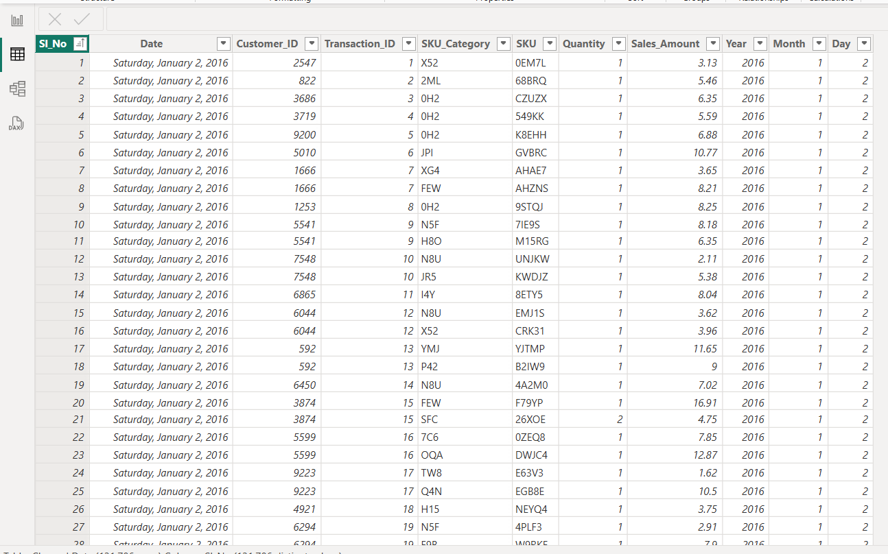
Data Cleaning Process
Using Power Query Editor-
Check any Empty / Null values in the dataset
Standardizing data types and formats
Added Columns for Analysis requirement(Year,Month,Day)

Slide 5
DAX Functions
TotalSales = SUM('Claened Data'[Sales_Amount])
AvgSalesPerCustomer = AVERAGE('Claened Data'[Sales_Amount])
TransactionCount = COUNT('Claened Data'[Transaction_ID])
UniqueCustomers = DISTINCTCOUNT('Claened Data'[Customer_ID])
HighestTransaction = MAX('Claened Data'[Sales_Amount])
LowestTransaction = MIN('Claened Data'[Sales_Amount])
SalesAboveThreshold = IF(SUM('Claened Data'[Sales_Amount]) > 10000, "High Sales", "Low Sales")
RevenuePerTransaction = DIVIDE(SUM('Claened Data'[Sales_Amount]), COUNT('Claened Data'[Transaction_ID]), 0)

Slide 6
DAX Functions
9. SalesGrowth = CALCULATE(SUM('Claened Data'[Sales_Amount]), DATEADD('Claened Data'[Date], -1, QUARTER))
10. RevenuePerCustomer =
DIVIDE(
SUM('Claened Data'[Sales_Amount]),
DISTINCTCOUNT('Claened Data'[Customer_ID]),
0 )

Slide 7
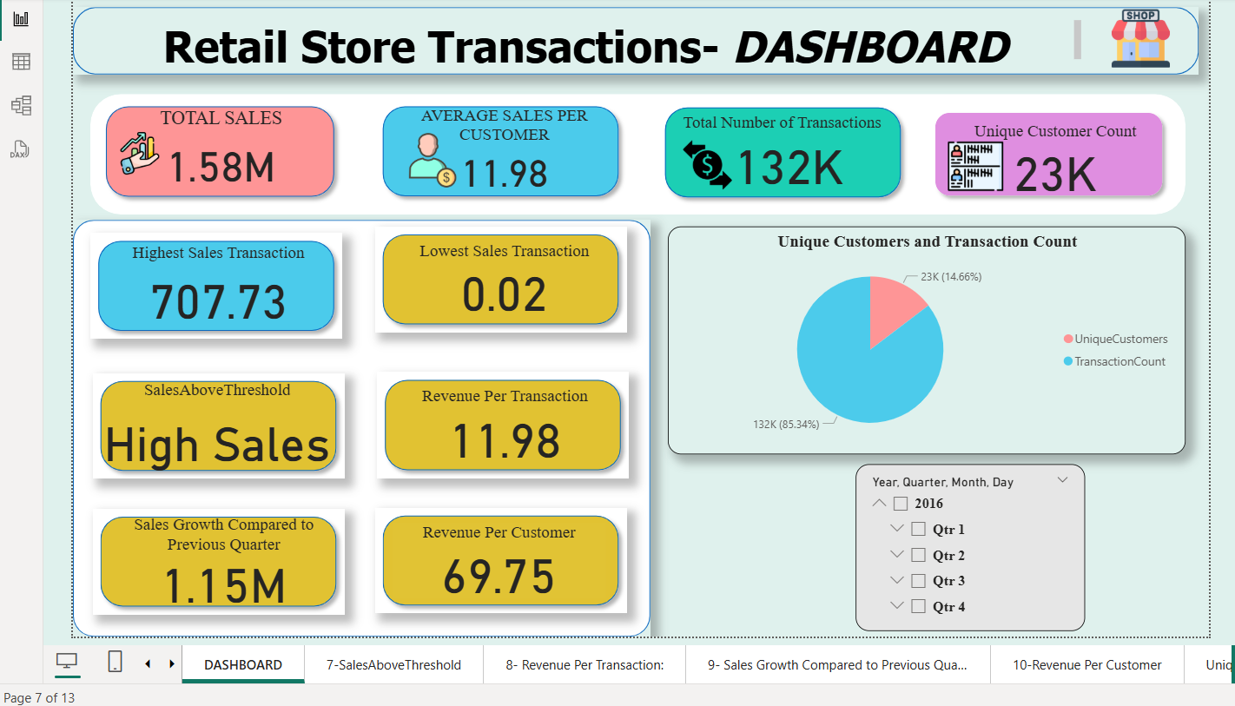
Dashboard Overview

Slide 8
Key Insights & Recommendations
Total sale in 2016 is $1.58M,Qtr 4 is the Highest sale season.
Revenue per Customer is $69.75
Unique Customer Count is 23 K

Slide 9
Thank you

